Slide 1
Minimum Cost Spanning Trees
CSC263 Tutorial 10

Slide 2
Minimum cost spanning tree (MCST)
What is a minimum cost spanning tree?
  Tree
    No cycles; equivalently, for each pair of nodes u and v, there is only one path from u to v
  Spanning
    Contains every node in the graph
  Minimum cost
    Smallest possible total weight of any spanning tree

Slide 3
Minimum cost spanning tree (MCST)
Let’s think about simple MCSTs on this graph:
a
1
b
5
2
4
c
d
3

Slide 4


Minimum cost spanning tree (MCST)
Black edges and nodes are in T
Is T a minimum cost spanning tree?
Not spanning; d is not in T.
1
a
b
5
2
4
c
d
3

Slide 5
Minimum cost spanning tree (MCST)
Black edges and nodes are in T
Is T a minimum cost spanning tree?
Not a tree; has a cycle.
1
a
b
5
2
4
c
d
3

Slide 6
Minimum cost spanning tree (MCST)
Black edges and nodes are in T
Is T a minimum cost spanning tree?
Not minimum cost; can swap edges 4 and 2.
1
a
b
5
2
4
c
d
3

Slide 7




Minimum cost spanning tree (MCST)
Which edges form a MCST?
1
1
a
b
a
b
3
3
4
2
4
2
c
d
c
d
3
3

Slide 8
Quick Quiz
If we build a MCST from a graph G = (V, E), how may edges does the MCST have?
When can we find a MCST for a graph?

Slide 9
An application of MCSTs
Electronic circuit designs (from Cormen et al.)
  Circuits often need to wire together the pins of several components to make them electrically equivalent.
  To connect n pins, we can use n - 1 wires, each connecting two pins.
  Want to use the minimum amount of wire.
  Model problem with a graph where each pin is a node, and every possible wire between a pair of pins is an edge.

Slide 10
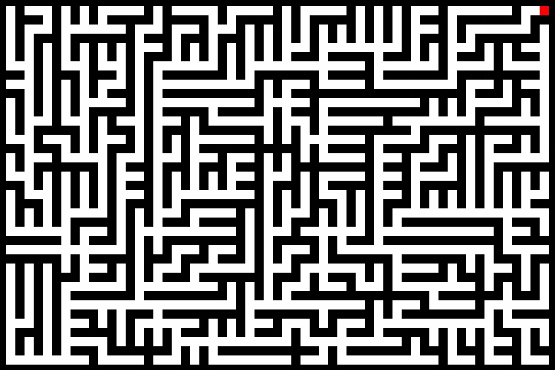
A few other applications of MCSTs
Planning how to lay network cable to connect several locations to the internet
Planning how to efficiently bounce data from router to router to reach its internet destination
Creating a 2D maze (to print on cereal boxes, etc.)

Slide 11
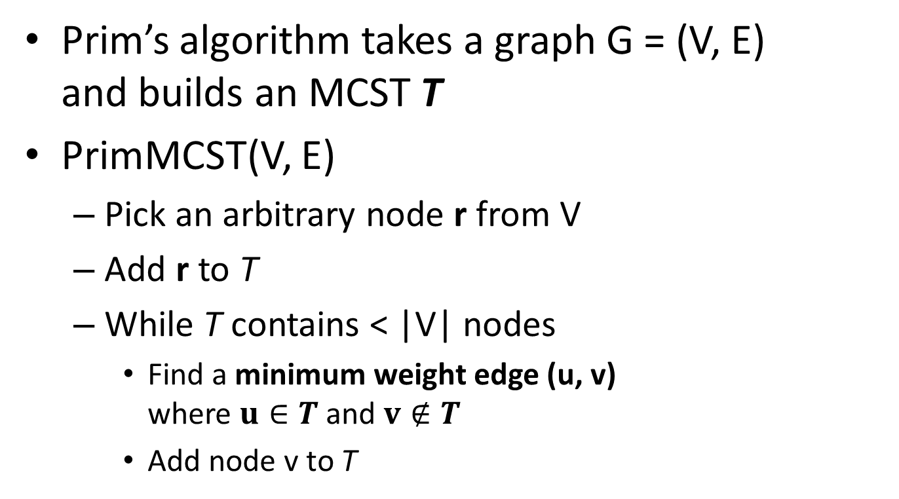
Building a MCST
In the book’s terminology, we find a light edge crossing the cut (T, V-T)
The book proves that adding |V|-1 such edges will create a MCST

Slide 12
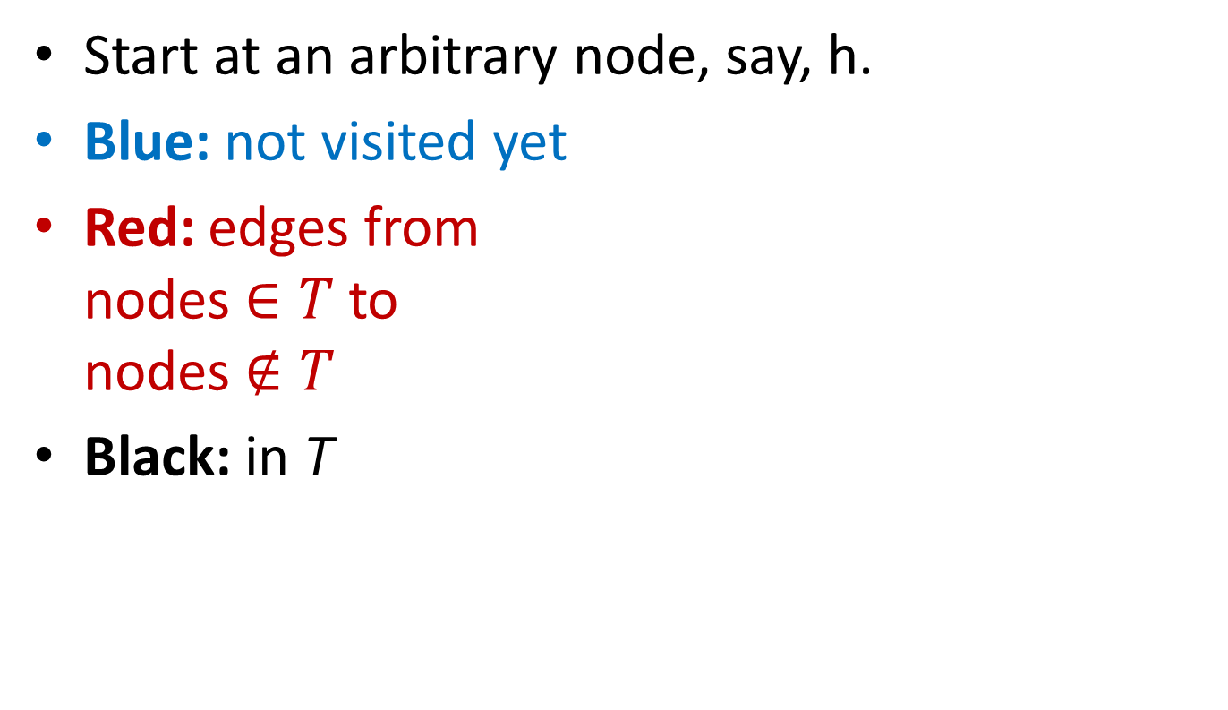
Running Prim’s algorithm
f
14
9
8
e
g
9
i
10
7
6
9
a
1
b
11
7
5
12
h
j
2
4
6
c
d
3

Slide 13

Running Prim’s algorithm
f
14
9
8
e
g
9
i
10
7
6
9
a
1
b
11
7
5
12
h
j
h
2
4
6
c
d
3

Slide 14

Running Prim’s algorithm
f
14
9
8
e
g
9
i
10
7
6
9
a
1
b
11
7
5
12
h
h
j
2
4
6
c
d
3

Slide 15
Running Prim’s algorithm
f
14
9
8
e
g
9
i
10
7
6
9
a
1
b
11
7
5
12
h
h
j
2
4
6
c
d
3

Slide 16
Running Prim’s algorithm
f
14
9
8
e
9
g
i
10
7
6
9
a
1
b
11
7
5
12
h
h
j
2
4
6
c
d
3

Slide 17

Running Prim’s algorithm
f
14
9
8
e
9
g
i
10
7
6
9
a
1
11
7
b
5
12
h
h
j
2
4
6
c
d
3

Slide 18

Running Prim’s algorithm
f
14
9
8
e
9
g
i
10
7
6
9
1
11
7
a
b
5
12
h
h
j
2
4
6
c
d
3

Slide 19
Running Prim’s algorithm
f
14
9
8
e
9
g
i
10
7
6
9
1
11
7
a
b
5
12
h
h
j
2
4
6
c
d
3

Slide 20
Running Prim’s algorithm
f
14
9
8
e
9
g
i
10
7
6
9
1
11
7
a
b
5
12
h
h
j
2
4
6
c
d
3

Slide 21

Running Prim’s algorithm
f
14
9
8
9
e
g
i
10
7
6
9
1
11
7
a
b
5
12
h
h
j
2
4
6
c
d
3

Slide 22
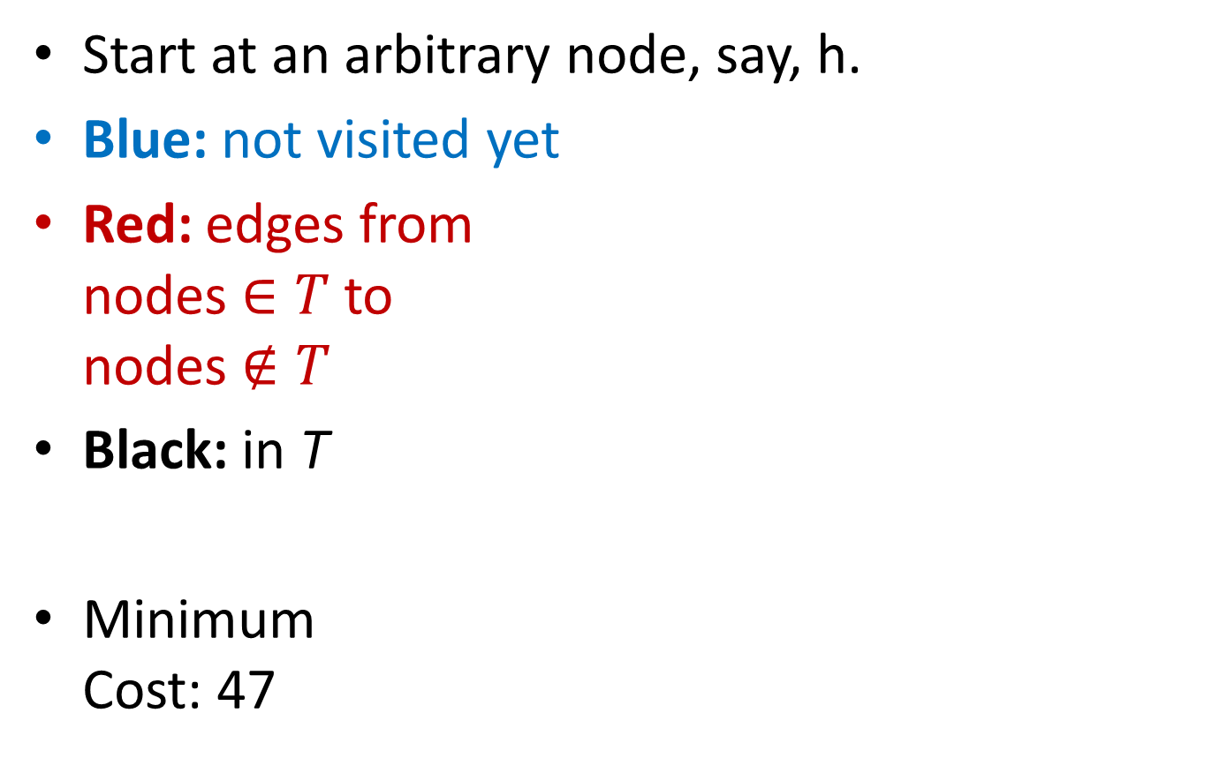

Running Prim’s algorithm
f
14
9
8
9
e
g
i
10
7
6
9
1
11
7
a
b
5
12
h
h
j
2
4
6
c
d
3

Slide 23
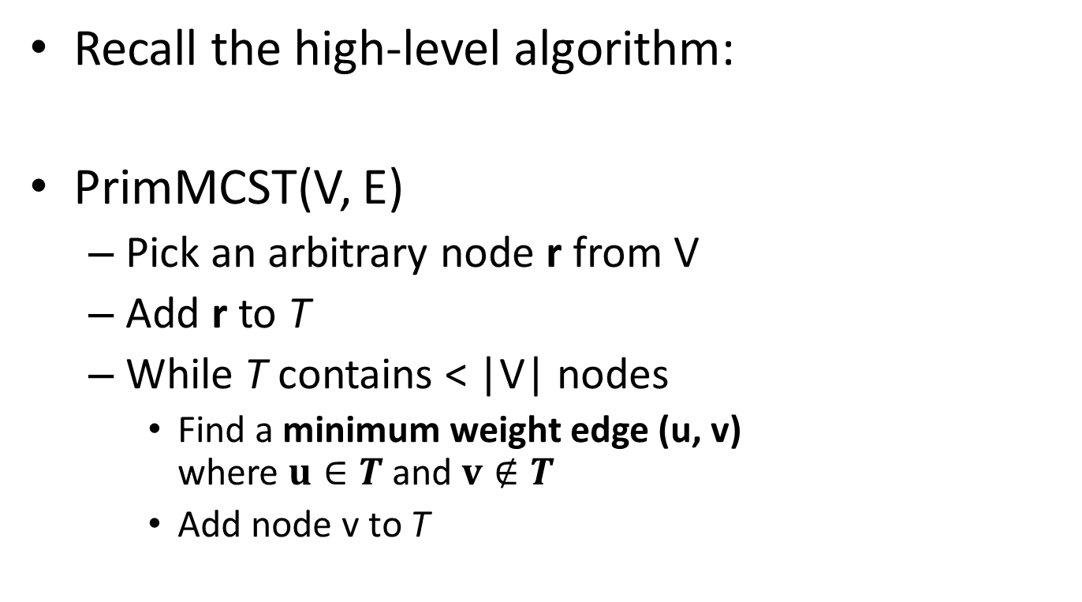
Implementing Prim’s Algorithm
How can we do this efficiently?
Finding lots of minimums?
Use a priority queue!

Slide 24
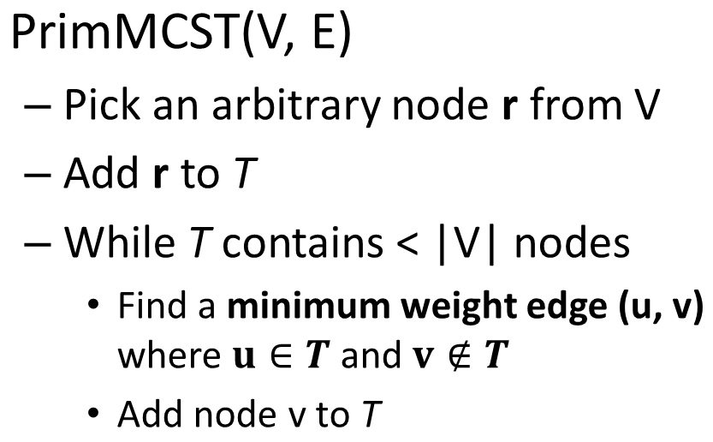
Adding a priority queue
What should we store in the priority queue?
  Edges
  From nodes in T
  to nodes not in T
What should we use as the key of an edge?
  Weight of the edge

Slide 25
Prim’s Algorithm with a priority queue
PrimMCST(V, E, r)
  Q := new priority queue
  For each u in V: inTree[u] = false, parent[u] = nil
  inTree[r] = true, parent[r] = r
  Add every edge that touches r to Q
  While Q is not empty
    Do Q.Extract-Min to get edge e = (u, v)
    If not inTree[v] then
      inTree[v] = true, parent[v] = u
      Add every edge that touches v to Q
where r is any arbitrary starting node

Slide 26
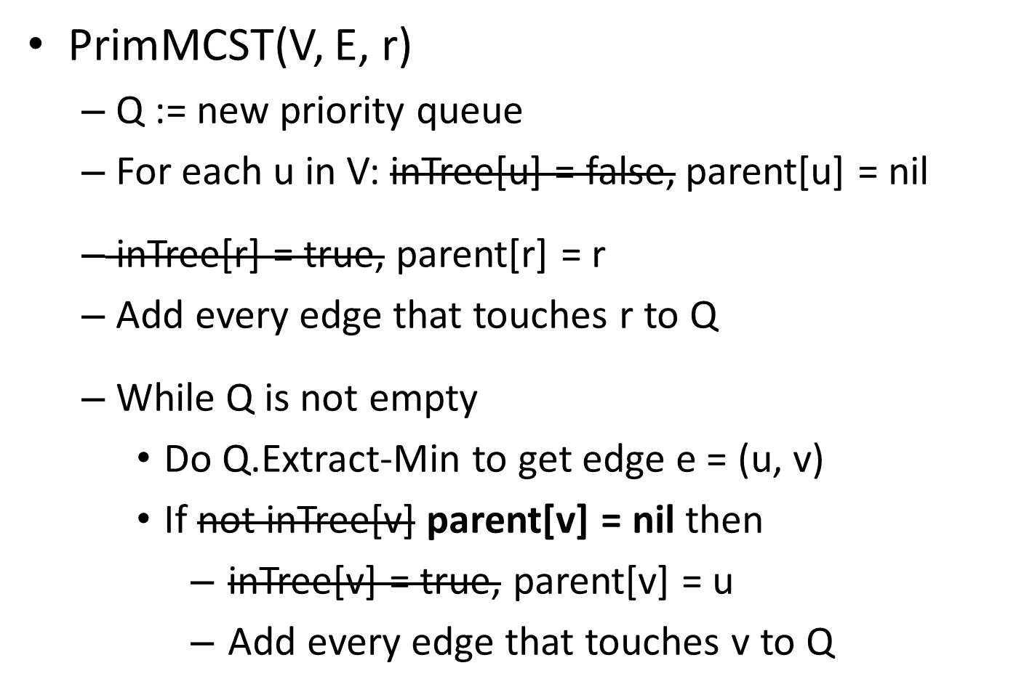
Small optimization

Slide 27
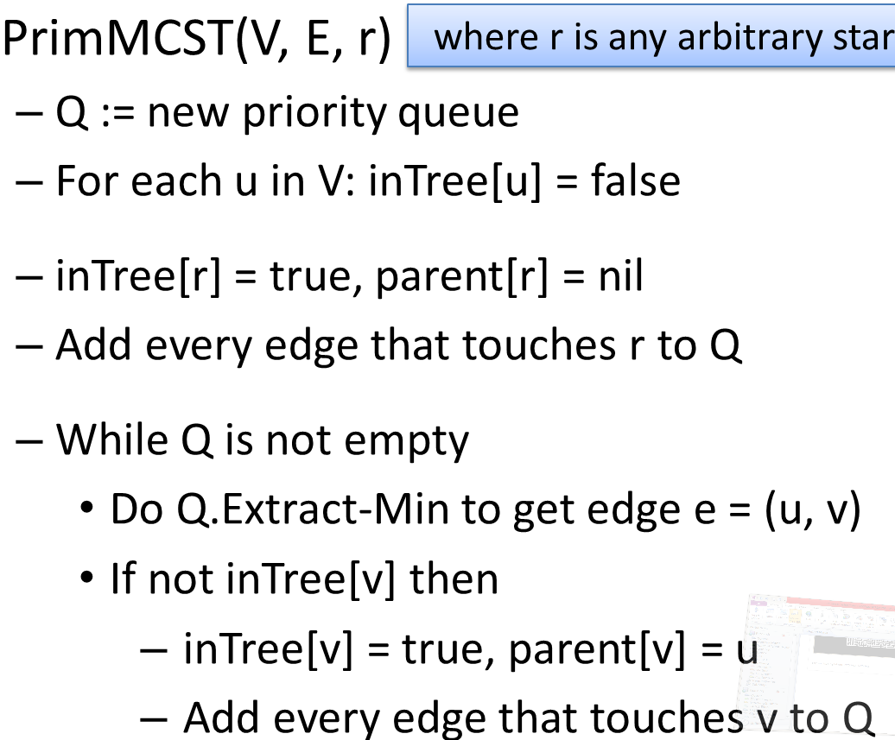
Analysis of running time
ϴ(|V|)
ϴ(|adj(r)| log |E|)
ϴ(log |E|)
ϴ(|E| log |E|)
ϴ(|adj(v)| log |E|)
O(|E| log |E|) = O(|E| log (|V|²))
= O(|E| 2 log |V|)
= O(|E| log |V|)

Slide 28
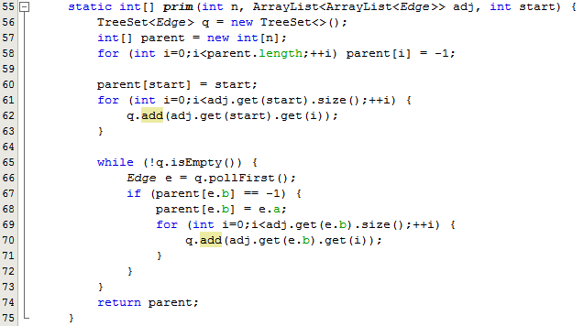
Java Implementation - 1

Slide 29
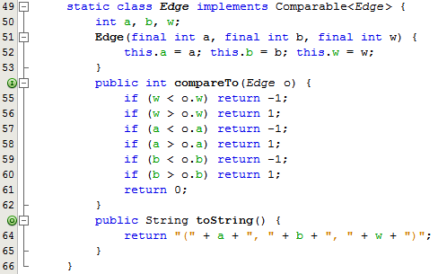
Java Implementation - 2

Slide 30

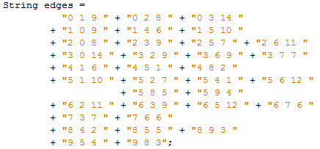
An example input
0
14
9
8
1
2
9
3
10
7
6
9
4
1
5
11
7
5
12
6
7
2
4
6
8
9
3

Slide 31
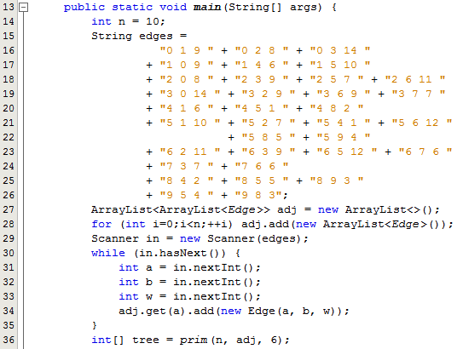
Java Implementation - 3

Slide 32

Java Implementation - 4
Outputting the answer:
The answer:
What does this look like?
Recall: the root is its own parent.

Slide 33
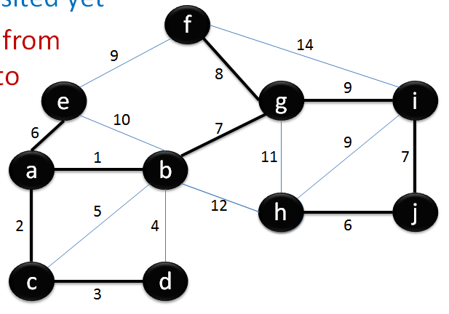




Drawing the answer
Recall our earlier solution by hand:
0
14
9
8
9
1
2
3
10
7
6
9
1
11
7
4
5
5
12
6
7
2
4
6
8
9
3

Slide 34
Fun example: generating 2D mazes
Prim’s algorithm maze building video
How can we use Prim’s algorithm to do this?
1. Create a graph that is a regular m x n grid.
2. Set all edge weights to random values!
3. Run Prim’s algorithm starting from any node.

Slide 35


Fun example: generating 2D mazes
After Prim’s, we end up with something like:

